Slide 1
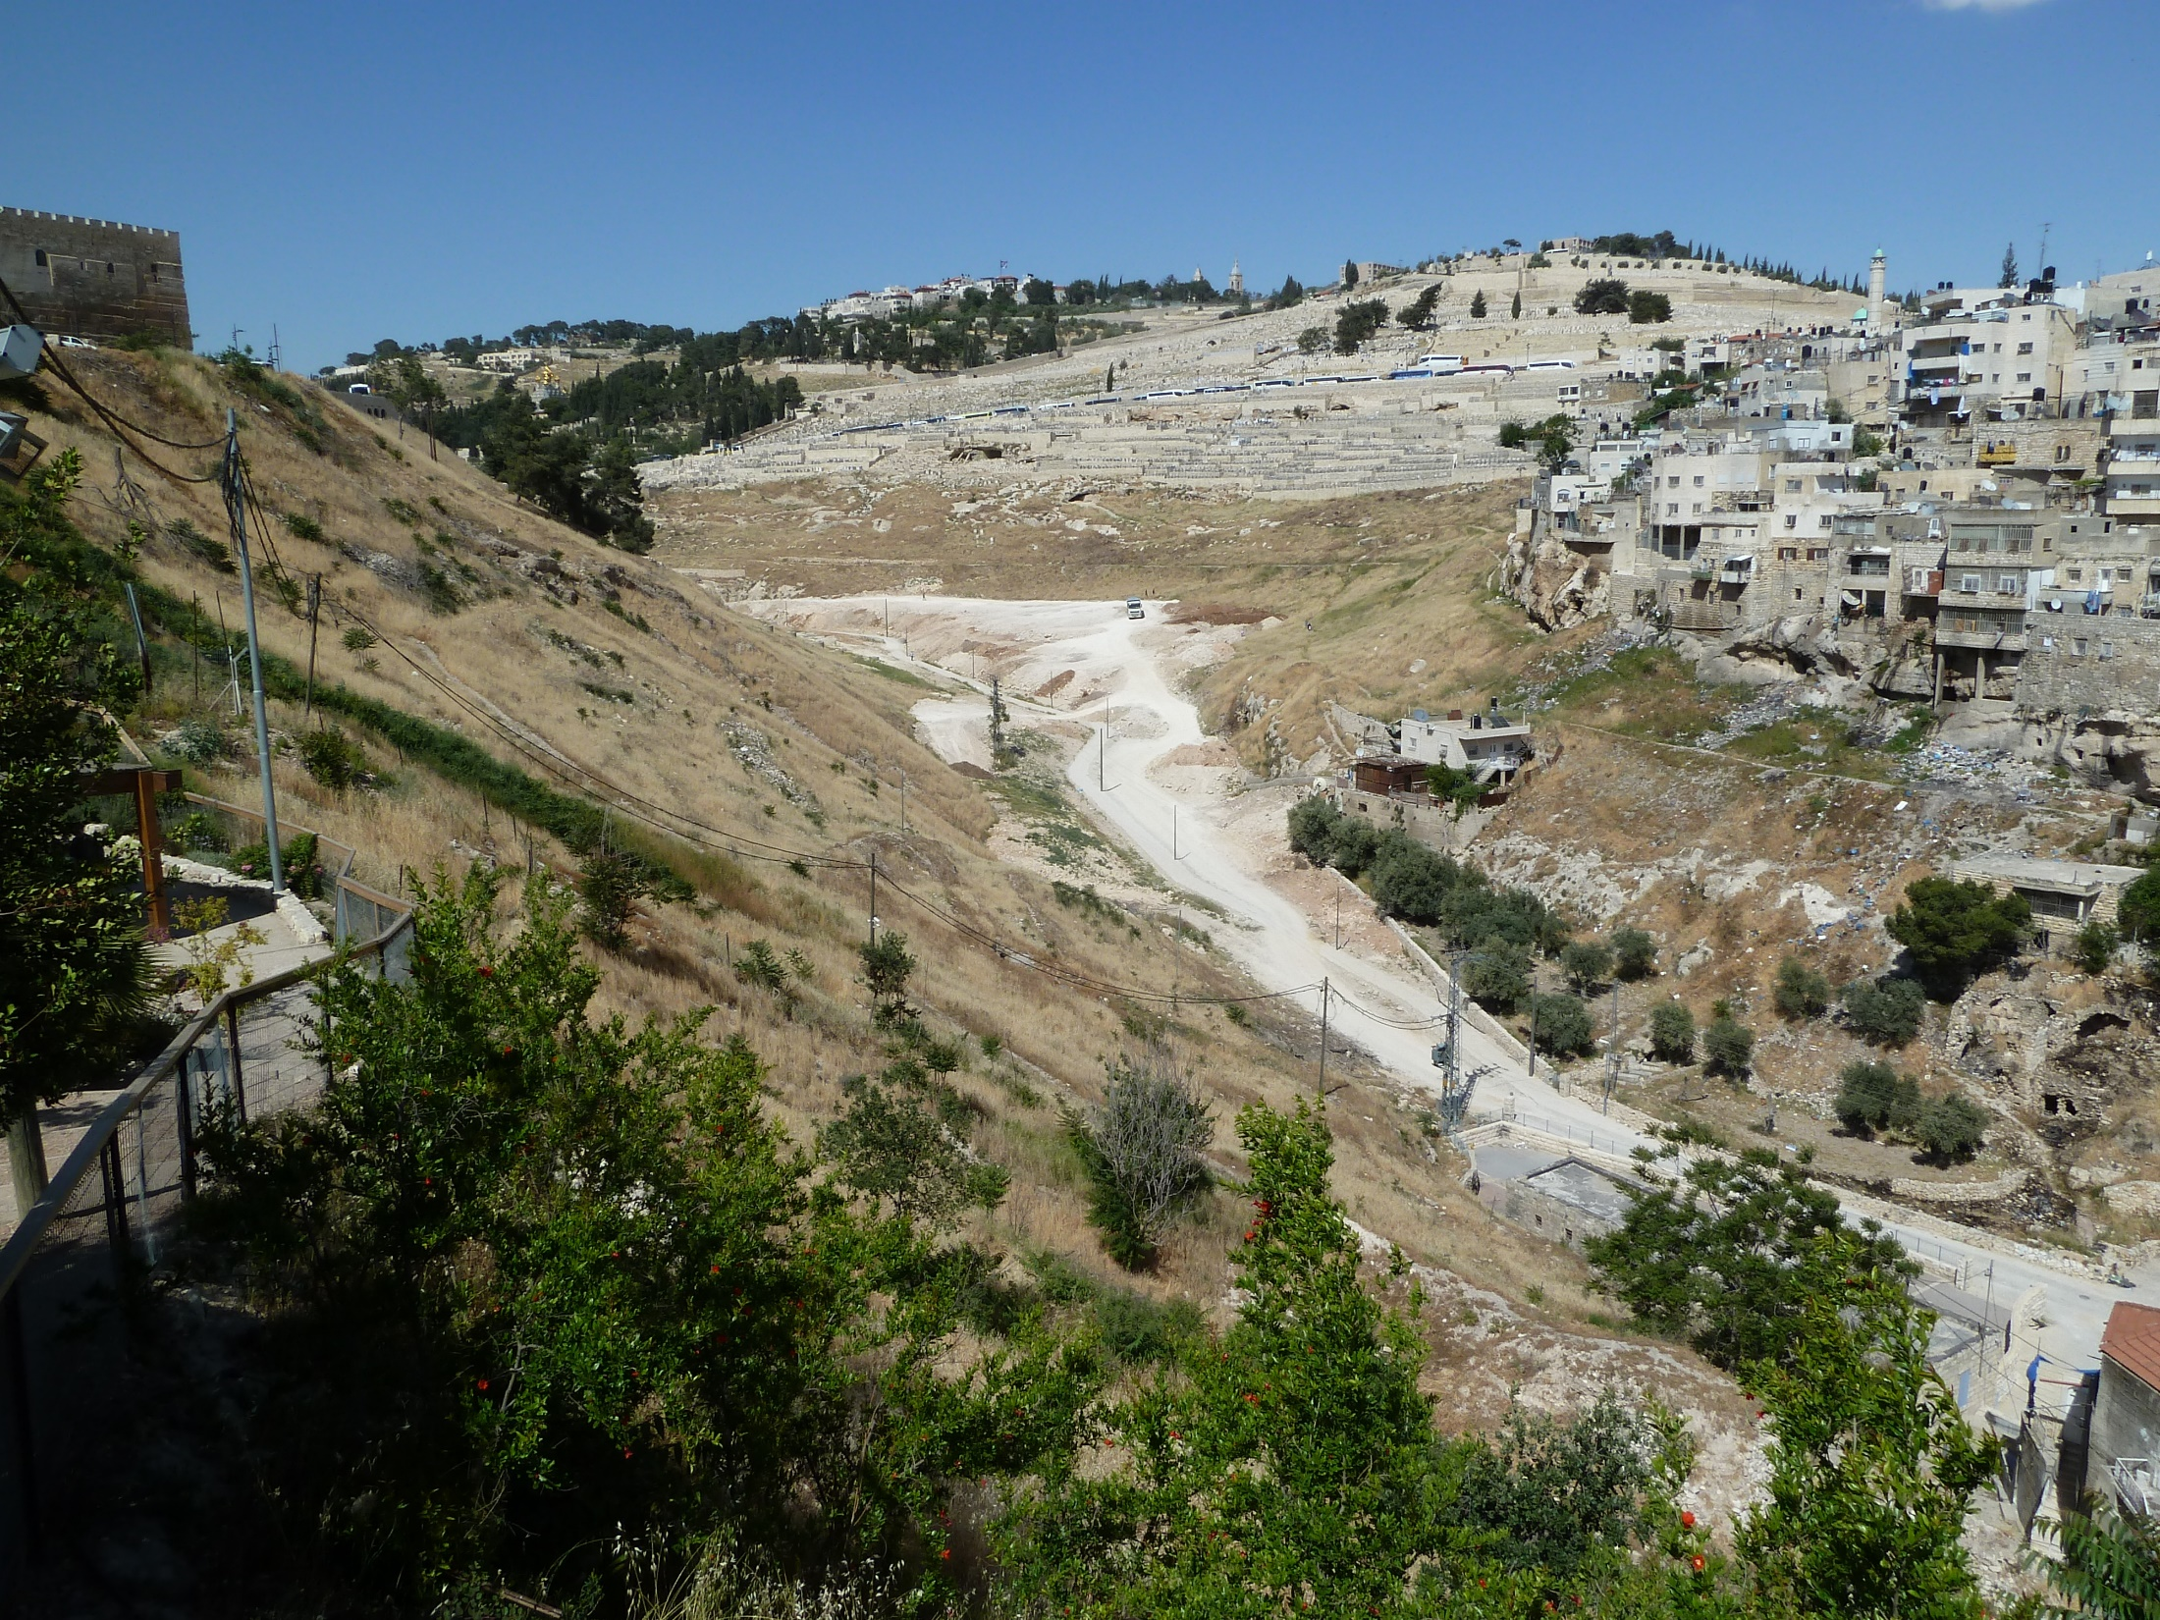
Temple Mount
Mt. of Olives
Kidron Valley
View from City of David

Slide 2
John 18.1 NIV: When he had finished praying, Jesus left with his disciples and crossed the Kidron Valley. On the other side there was a garden, and he and his disciples went into it.

Slide 3
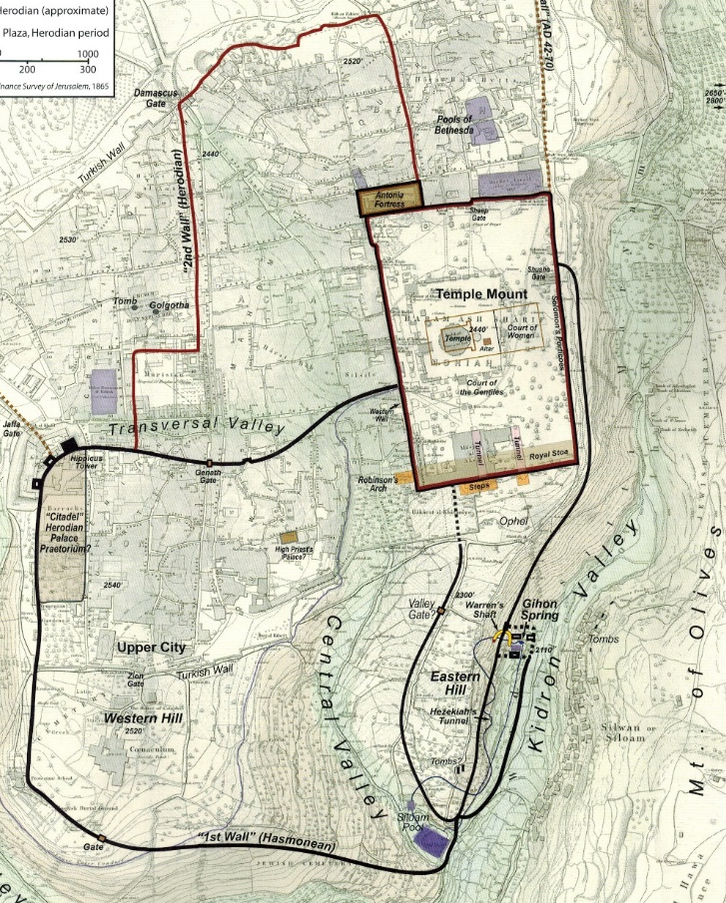
E
F
E
G
E
F
G
B
F
G
D
F
A
G
C
F
G

Slide 4
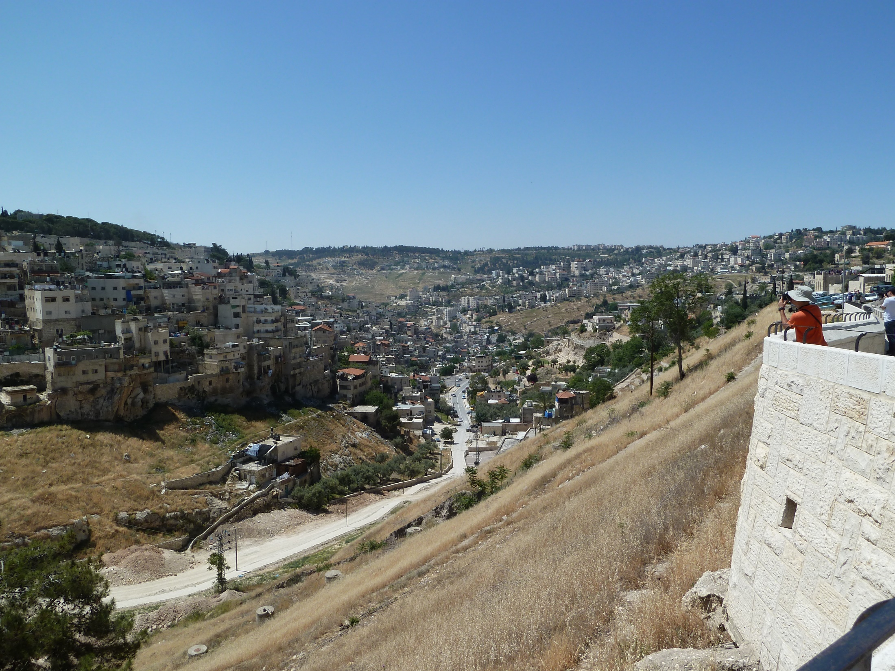

Slide 5
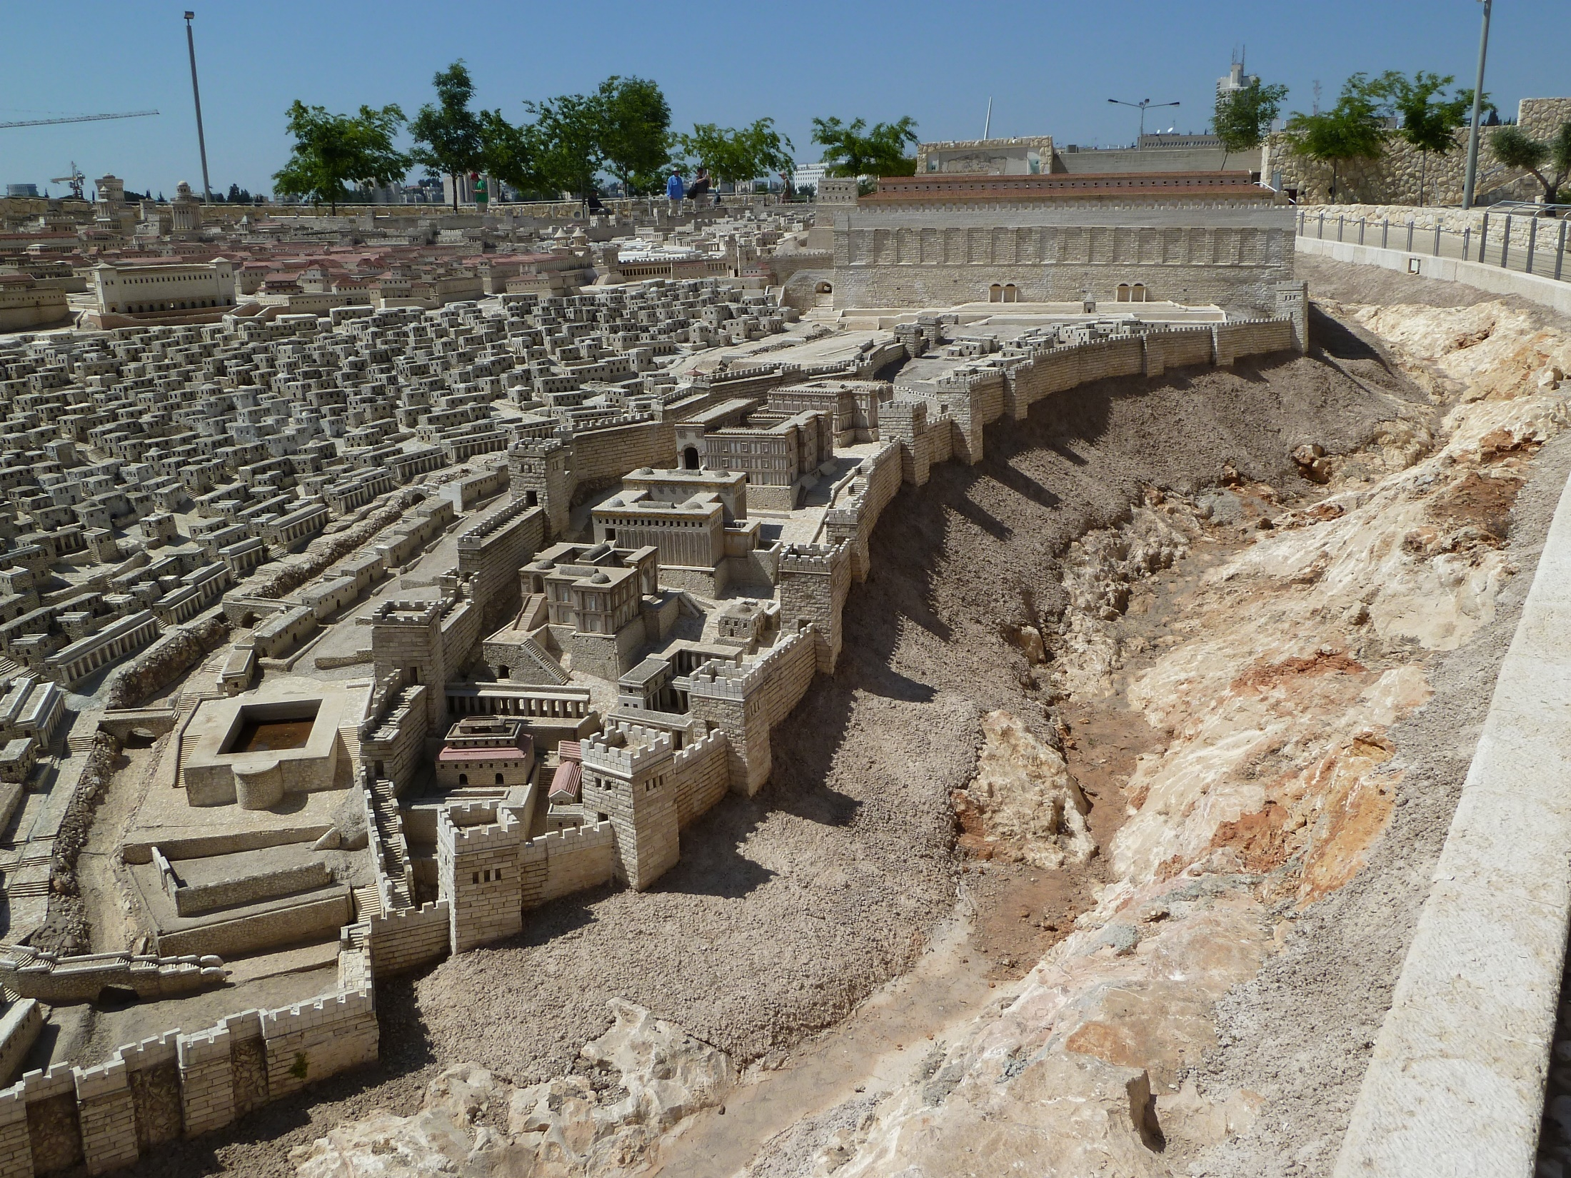
E
B
D
F
G
F
A
C
G
F
G
F

Slide 6
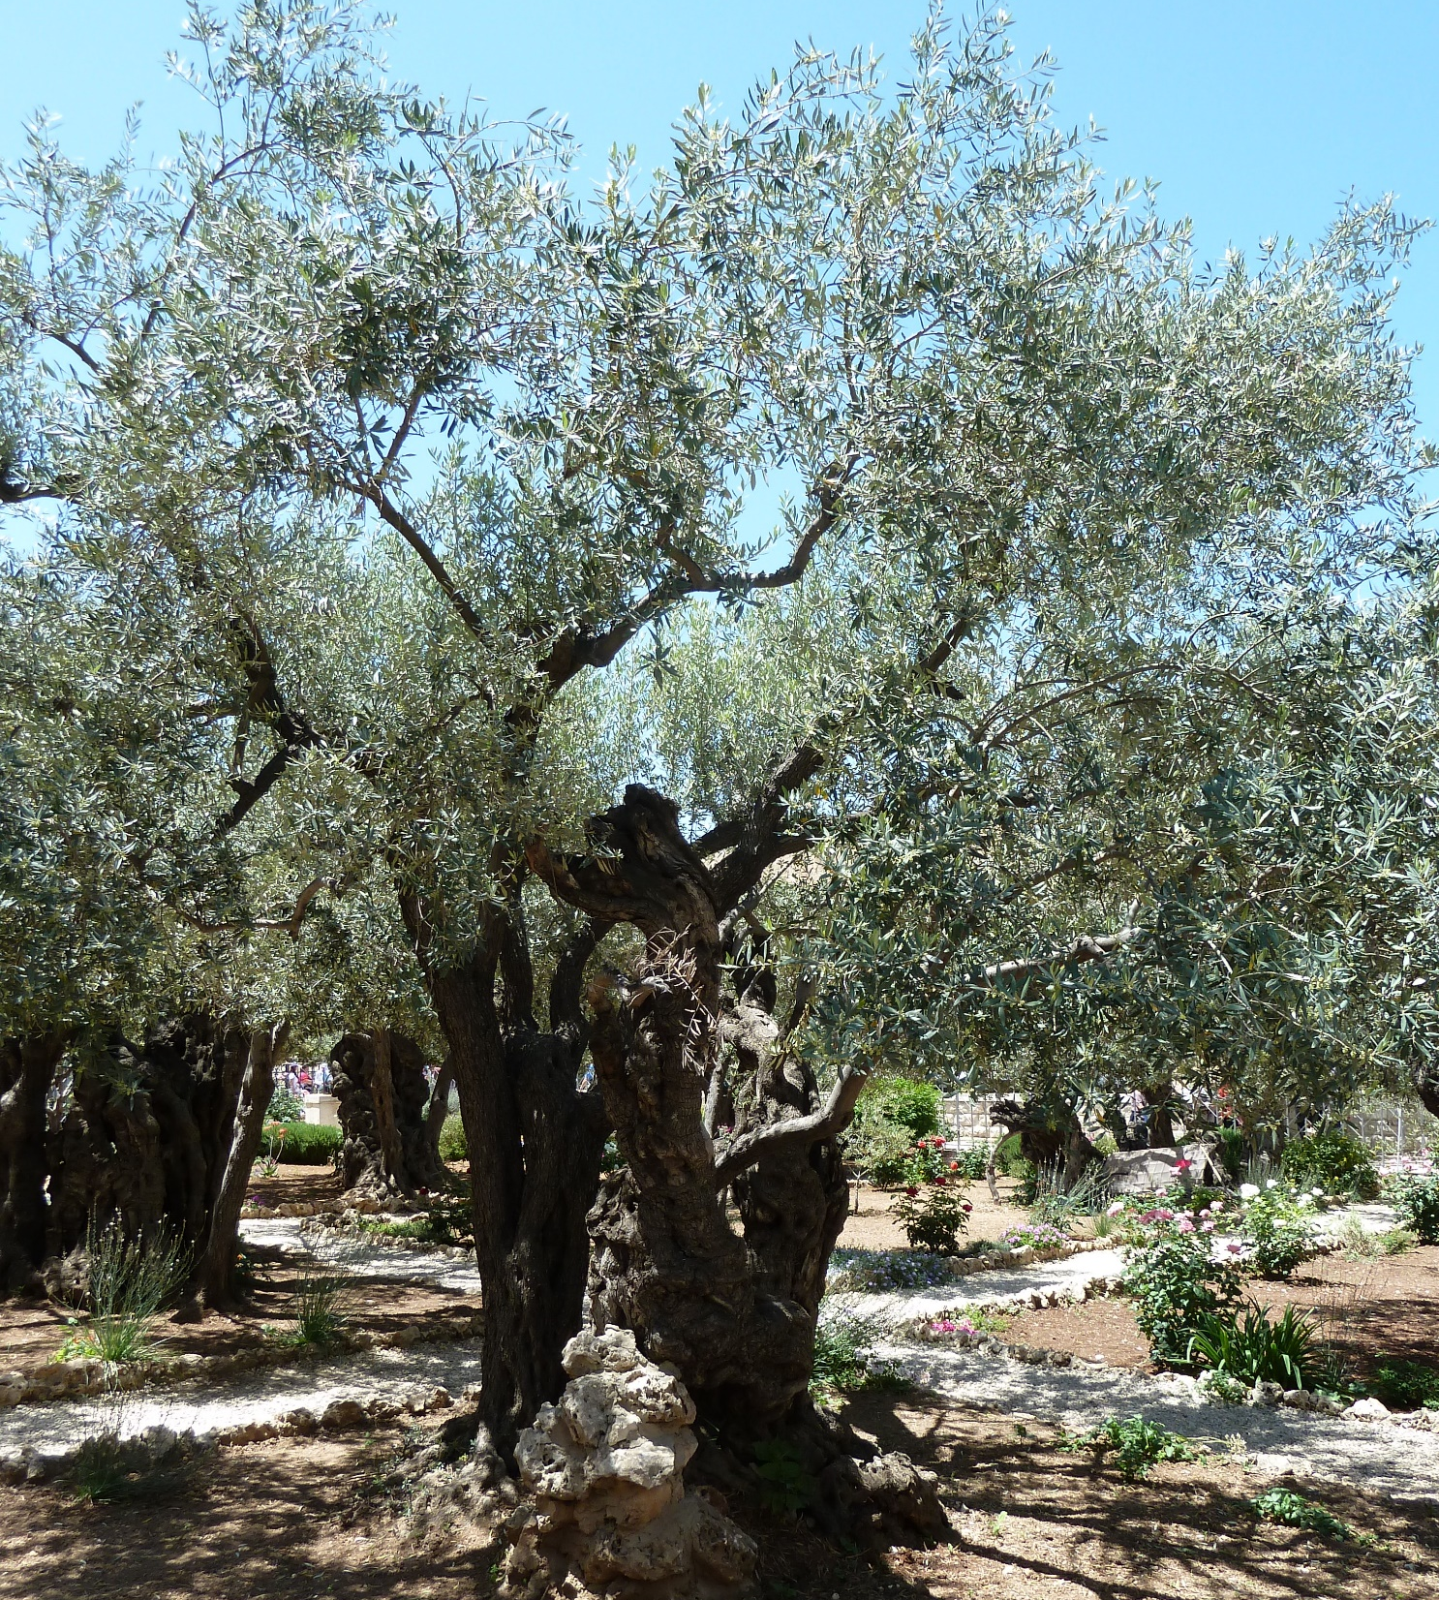

Slide 7
John 18.2-3: Now Judas, who betrayed him, knew the place, because Jesus had often met there with his disciples. So Judas came to the garden, guiding a detachment of soldiers and some officials from the chief priests and the Pharisees. They were carrying torches, lanterns and weapons.

Slide 8
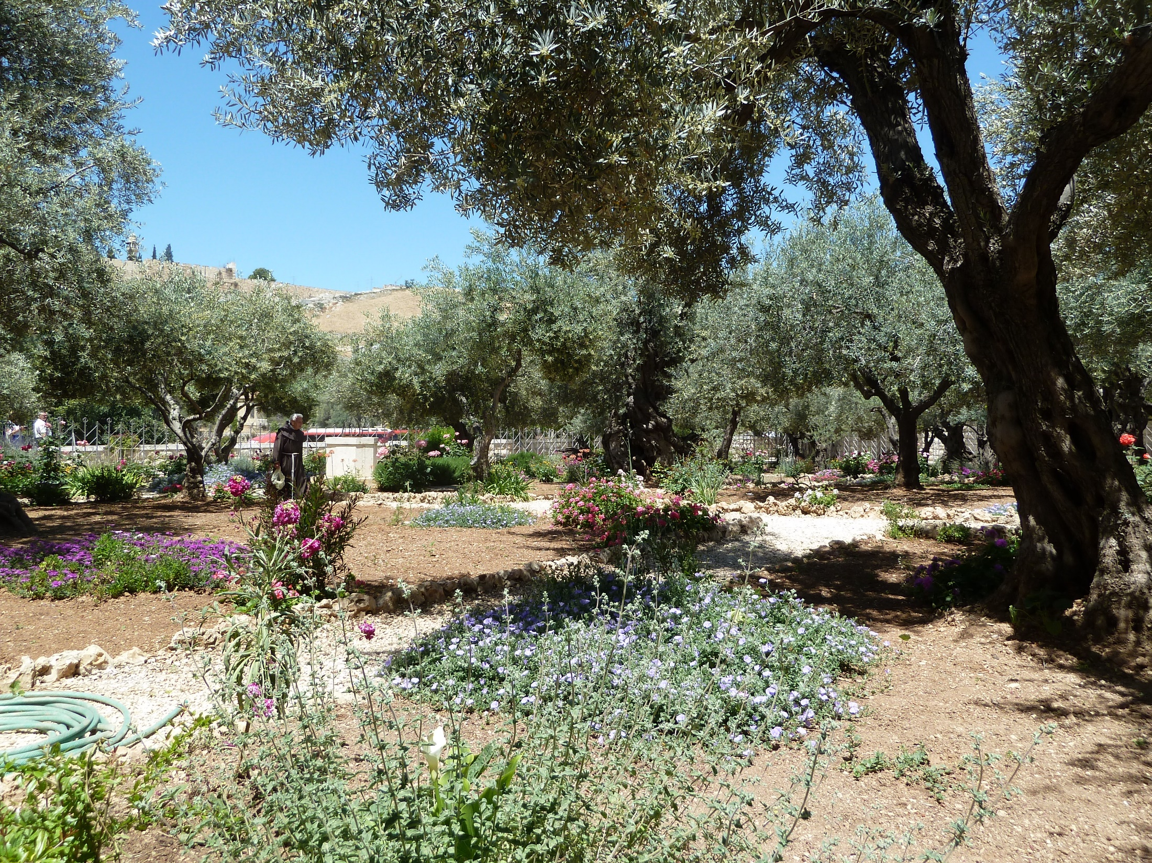
John 18.4-6: Jesus, knowing all that was going to happen to him, went out and asked them, “Who is it you want?” “Jesus of Nazareth,” they replied. “I am he,” Jesus said. (And Judas the traitor was standing there with them.) When Jesus said, “I am he,” they drew back and fell to the ground.

Slide 9
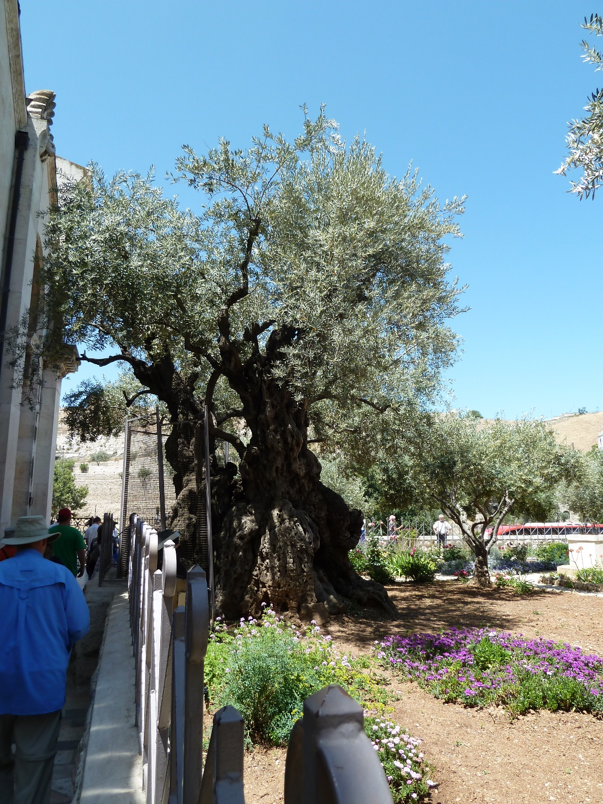
John 18.7-9: Again he asked them, “Who is it you want?” “Jesus of Nazareth,” they said. Jesus answered, “I told you that I am he. If you are looking for me, then let these men go.” This happened so that the words he had spoken would be fulfilled: “I have not lost one of those you gave me.”

Slide 10
John 18.10-11: Then Simon Peter, who had a sword, drew it and struck the high priest's servant, cutting off his right ear. (The servant's name was Malchus.) Jesus commanded Peter, “Put your sword away! Shall I not drink the cup the Father has given me?”

Slide 11
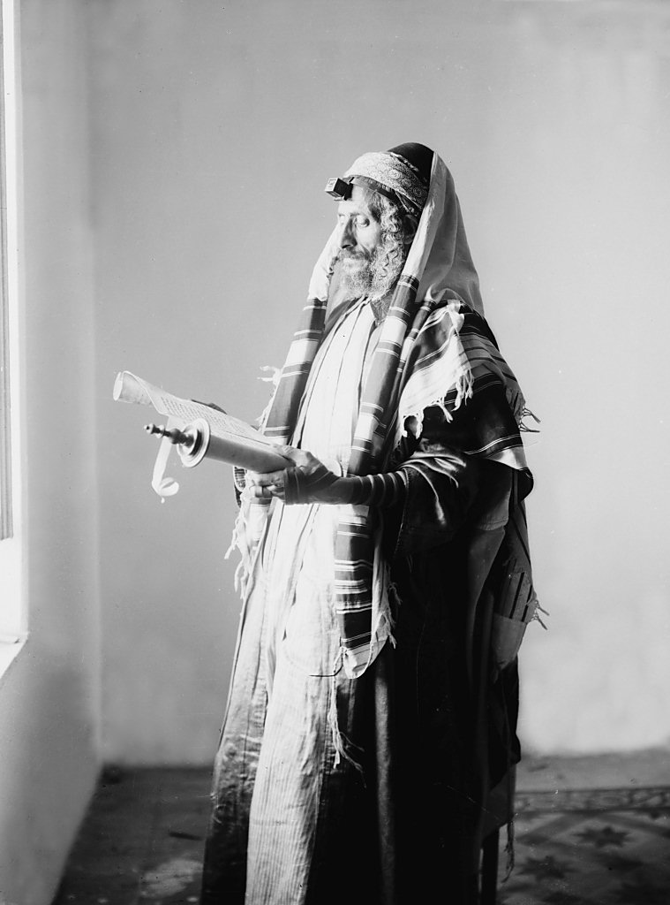
John 18.12-14: Then the detachment of soldiers with its commander and the Jewish officials arrested Jesus. They bound him and brought him first to Annas, who was the father-in-law of Caiaphas, the high priest that year. Caiaphas was the one who had advised the Jewish leaders that it would be good if one man died for the people.
Matson: Life in the Holy Land
© 2009 Todd Bolen

Slide 12
John 18.15-18: Simon Peter and another disciple were following Jesus. Because this disciple was known to the high priest, he went with Jesus into the high priest's courtyard, but Peter had to wait outside at the door. The other disciple, who was known to the high priest, came back, spoke to the servant girl on duty there and brought Peter in. “You aren't one of this man's disciples too, are you?” she asked Peter. He replied, “I am not.” It was cold, and the servants and officials stood around a fire they had made to keep warm. Peter also was standing with them, warming himself.

Slide 13
John 18.19-21: Meanwhile, the high priest questioned Jesus about his disciples and his teaching. “I have spoken openly to the world,” Jesus replied. “I always taught in synagogues or at the temple, where all the Jews come together. I said nothing in secret. Why question me? Ask those who heard me. Surely they know what I said.”
Matson: Life in the Holy Land
© 2009 Todd Bolen

Slide 14
John 18.22-24: When Jesus said this, one of the officials nearby slapped him in the face. “Is this the way you answer the high priest?” he demanded. “If I said something wrong,” Jesus replied, “testify as to what is wrong. But if I spoke the truth, why did you strike me?” Then Annas sent him bound to Caiaphas the high priest.
Matson: Life in the Holy Land
© 2009 Todd Bolen

Slide 15
John 18.25-27: Meanwhile, Simon Peter was still standing there warming himself. So they asked him, You aren't one of his disciples too, are you?” He denied it, saying, “I am not.”
One of the high priest's servants, a relative of the man whose ear Peter had cut off, challenged him, “Didn't I see you with him in the garden?” Again Peter denied it, and at that moment a rooster began to crow.

